Slide 1

DriverPass System Analysis
[Your Name]
Notes:
This presentation provides an overview of the proposed DriverPass system and how the design supports the needs of the business, its employees, and its customers. The goal is to provide one online system where customers can access training, take practice tests, schedule driving lessons, and manage their accounts. DriverPass employees will also be able to manage appointments, customer information, training content, and other daily business activities from the same system.

Slide 2

System Requirements
Online access from computers and mobile devices
Customer and employee accounts
Online training and practice tests
Driving lesson scheduling
Instructor and vehicle availability
Current DMV training information
Customer progress and business reporting
Notes:
The DriverPass system is designed to bring the company's major services together in one place. Customers will be able to access their accounts from a computer or mobile device, purchase training packages, complete online training and practice tests, and schedule driving lessons. When a lesson is scheduled, the system will check that an instructor and vehicle are available to prevent scheduling conflicts. DriverPass employees will be able to manage customer accounts and appointments, while management will have access to information needed to monitor the business. The system will also use DMV updates to help keep training materials current.

Slide 3
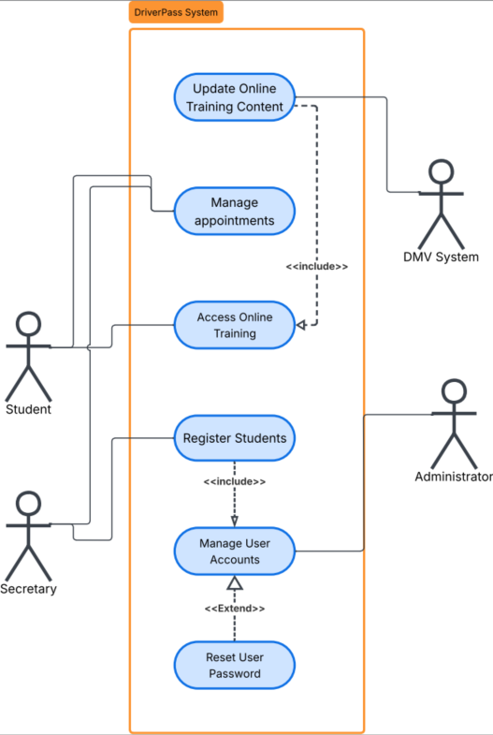
Use Case Diagram
Notes:
This diagram provides an overview of who will use DriverPass and what they will be able to do. Students can access online training and manage appointments, while the secretary can assist with appointments and student registration. Administrators can manage user accounts, including password resets, and the DMV provides information used to keep online training content current. The purpose of this design is to make sure each type of user has access to the services they need without making the system unnecessarily complicated.

Slide 4
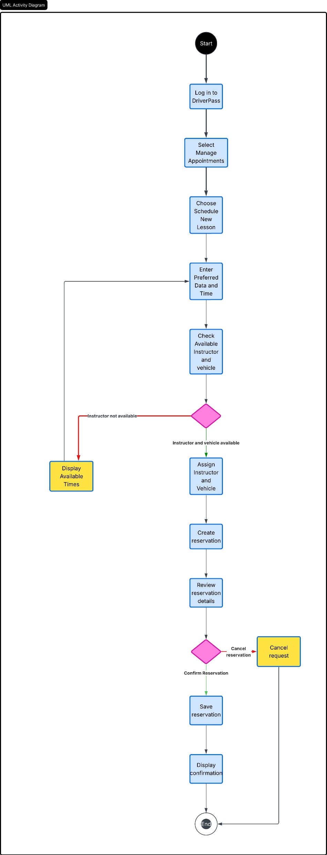
Activity Diagram
Notes:
This diagram shows what happens when a customer schedules a driving lesson. After signing in and selecting the appointment option, the customer chooses a preferred date and time. DriverPass then checks whether both an instructor and a vehicle are available. If either is unavailable, the customer is shown other available times instead of creating a conflicting reservation. Once the necessary resources are available, the system creates the reservation and allows the customer to review and confirm it. This process helps DriverPass manage its instructors and vehicles efficiently while giving customers a straightforward way to schedule lessons.

Slide 5
Security
Individual user accounts
Password-protected access
Access based on user responsibilities
Secure customer information
Protected online communication
Activity records for accountability
Notes:
Security is important because DriverPass will store customer, employee, scheduling, and training information. Each person will have an individual account protected by a password, and access will depend on that person's responsibilities. For example, a customer does not need the same level of access as an administrator. Information sent between users and DriverPass will also need to be protected while it travels over the internet. Keeping records of important account activity will provide additional accountability and can help DriverPass investigate problems if they occur.

Slide 6
System Limitations
Requires a reliable internet connection
Depends on DMV information being available and current
Limited functionality without online access
Initial version is limited to agreed-upon features
Future growth may require additional resources
Notes:
There are some limitations DriverPass should consider with this design. Because the system is web-based, customers and employees will need an internet connection to use its services, and there will be limited functionality if that connection is unavailable. DriverPass will also depend on the DMV providing current information for training updates, so delays from that outside source could affect how quickly content can be updated. The initial system will focus on the features DriverPass has requested rather than trying to include every possible feature at launch. As the number of customers and services grows, the system can be expanded to provide additional capacity and functionality.

